Slide 1
Machine Translation with Diverse Data Sources
Huda Khayrallah
This talk was presented at NYU Abu Dhabi
CS seminar on September 1, 2019
It is based on the following papers:
https://aclweb.org/anthology/W18-2705
(bibtex: https://aclweb.org/anthology/W18-2705)
https://aclweb.org/anthology/W18-2709
(bibtex: https://aclweb.org/anthology/W18-2709.bib)
Notes:
Paracrawl is high recall
Option with paracawrl is to use a filtered version
but we want to see what kind of noise exists to improve it
what kind of noise in data to motivate future filtering work
Shared task – did will, beat zipporah

Slide 2
Machine Translation with Diverse Data Sources
Huda Khayrallah
huda@jhu.edu
Work with:
Brian Thompson, Kevin Duh & Philipp Koehn

Slide 3
Overview
Overview of Neural Machine Translation (NMT)
Overview of Domain Adaptation
Improving Domain Adaptation
Regularized Training Objective for Continued Training for Domain Adaptation in Neural Machine Translation [Khayrallah, Thompson, Duh & Koehn 2018]
Analysis of Noisy Corpora
On the Impact of Various Types of Noise on Neural Machine Translation [Khayrallah & Koehn 2018]

Slide 4



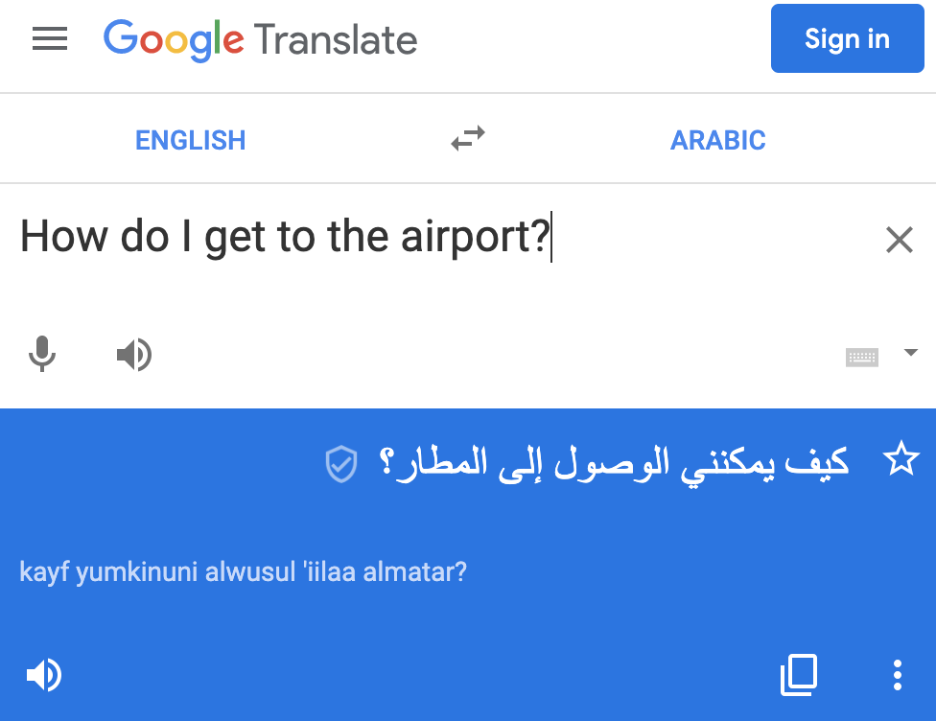
Machine Translation
Notes:
The translation is not wrong… but it might not be the right level of formality or the right dialect

Slide 5
Neural Machine Translation
Notes:
translate from German to English for this example
Focus on RNN for this talk – though the work I’m discussing could also be applied to the transformer model

Slide 6
Parallel Text
Die Koalas sind süß
Die Kängurus springen
Der Koala ist weich
Das Känguru ist schnell
The koalas are cute
The kangaroos jump
The koala is soft
The kangaroo is fast

Slide 7
Wasch
dir
die
Hände

Slide 8
Embedding
Source
Wasch
dir
die
Hände

Slide 9
Encoder
Embedding
Source
Wasch
dir
die
Hände

Slide 10
Decoder
Encoder
Embedding
Source
Wasch
dir
die
Hände

Slide 11
Softmax
Decoder
Encoder
Embedding
Source
Wasch
dir
die
Hände

Slide 12
Softmax
Decoder
Encoder
Embedding
Source
Wasch
dir
die
Hände

Slide 13
Wash
Softmax
Decoder
Encoder
Embedding
Source
Wasch
dir
die
Hände

Slide 14
Wash
Embedding
Target
Softmax
Decoder
Encoder
Embedding
Source
Wasch
dir
die
Hände

Slide 15
Wash
Embedding
Target
Softmax
Decoder
Encoder
Embedding
Source
Wasch
dir
die
Hände

Slide 16
Wash
hands
your
Embedding
Target
Softmax
Decoder
Encoder
Embedding
Source
Wasch
dir
die
Hände
Notes:
Trained end-to-end on parallel text, loss comes from one word prediction at a time
Data hungry -- millions of sentences

Slide 17
NMT loss function
Gold Target
Model output
Cross Entropy( , )
Gold Target
Model output
Notes:
Cross entropy loss between two distributions
Gold label is one hot vector of the correct word
You can think of this loss as trying to make the model output distribution match the gold target distribution – which is a one hot vector

Slide 18

BLEU
Weighted n-grams precision
Between 0 and 1
(often scaled to be 0-100)
Higher is better
Imperfect…
But… not bad
$$min\left(1,\frac{output length}{reference length}\right){\left(\prod_{i=1}^{4}{{precision}_{i}}\right)}^{\frac{1}{4}}$$
Notes:
standard metric in MT
higher better
counts how many words or phrases you got right compared to a reference
Problems with bleu:
Ignore relevance of words: punctuation counts the same as core content
Operate on local level (do not consider overall grammaticality of the sentence or sentence meaning)
absolute value of Scores are meaningless (scores very test-set specific) pros:
Correlated with human judgement
Easy to run
easy to tune
Widely used

Slide 19
Overview
Overview of Neural Machine Translation (NMT)
Overview of Domain Adaptation
Improving Domain Adaptation
Regularized Training Objective for Continued Training for Domain Adaptation in Neural Machine Translation [Khayrallah, Thompson, Duh & Koehn 2018]
Analysis of Noisy Corpora
On the Impact of Various Types of Noise on Neural Machine Translation [Khayrallah & Koehn 2018]

Slide 20

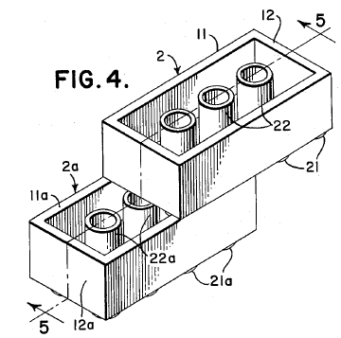
What do we want to translate?

Slide 21
Developmental toxicity, including dose-dependent delayed foetal ossification and possible teratogenic effects, were observed in rats at doses resulting in subtherapeutic exposures (based on AUC) and in rabbits at doses resulting in exposures 3 and 11 times the mean steady-state AUC at the maximum recommended clinical dose.
Notes:
Sentence from:
http://opus.nlpl.eu/EMEA.php
Sentence from:
http://opus.nlpl.eu/EMEA.php
/exp/hkhayrallah/whale17/domain_adapt/data/raw/emea-test.en

Slide 22
The films coated therewith, in particular polycarbonate films coated therewith, have improved properties with regard to scratch resistance, solvent resistance, and reduced oiling effect, said films thus being especially suitable for use in producing plastic parts in film insert molding methods.
Notes:
Sentence from: WIPO

Slide 23



General Domain Data
Notes:
Basically whatever we can find! not a lot of parallel text is produced
Biggest sources are EU parliament, UN, subtitles

Slide 24
General Domain Data
Would it not be beneficial, in the short term, following the Rotterdam model, to inspect according to a points system in which, for example, account is taken of the ship's age, whether it is single or double-hulled or whether it sails under a flag of convenience.
Notes:
Sentence from:
http://www.statmt.org/europarl/
/home/pkoehn/statmt/data/wmt15/training/europarl-v7.de-en.en

Slide 25
General Domain Data
Mama always said there's an awful lot you can tell about a person by their shoes.
Notes:
Sentence from:
http://www.statmt.org/europarl/
/home/pkoehn/statmt/data/wmt15/training/europarl-v7.de-en.en

Slide 26
Domain Mismatch
Notes:
data we want to translate differs from the vast majority of training data
DIALECT MISMATCH – similar setting

Slide 27
Case Study: Translating Russian Patents
Notes:
Case study. Translating from Russian in to English

Slide 28
General Domain NMT
General Domain
NMT Model
50m General Domain
sentence pairs
Notes:
subtitles, UN, etc
"google translate model"

Slide 29
General Domain NMT
Errors due to domain mismatch
General Domain
NMT Model
50m General Domain
sentence pairs
дверной замок повышенной степени защищенности от взлома Human: door lock with increased degree of security against burglary
System: door security door security door

Slide 30
In-Domain NMT
In-Domain
NMT Model
30k In-Domain
sentence pairs
Notes:
1000x smaller

Slide 31
In-Domain NMT
Errors due to lack of data
In-Domain
NMT Model
30k In-Domain
sentence pairs
дверной замок повышенной степени защищенности от взлома Human: door lock with increased degree of security against burglary
System: door lock for a high degree of protection against coke

Slide 32
Domain Adaptation
Notes:
data we want to translate differs from the vast majority of training data

Slide 33
Continued Training
General Domain
NMT
Model
Continued Training
NMT
Model
30k In-domain
sentence pairs
50m General Domain
sentence pairs
Notes:
ct model in purple has seen both the in and general domain data

Slide 34
Continued Training
Improved
performance!
General Domain
NMT
Model
Continued Training
NMT
Model
30k In-domain
sentence pairs
50m General Domain
sentence pairs
дверной замок повышенной степени защищенности от взлома Human: door lock with increased degree of security against burglary
System: door lock with increased penetration protection

Slide 35

Russian → English Patents
+ 9.3
BLEU
Notes:
1000x less data is better when it is better data

Slide 36
Russian → English General
-18.2
BLEU
Notes:
Look back at how we did on General Domain
Not great. WE ARE OBVIOUSLY FITTEING

Slide 37
Overview
Overview of Neural Machine Translation (NMT)
Overview of Domain Adaptation
Improving Domain Adaptation
Regularized Training Objective for Continued Training for Domain Adaptation in Neural Machine Translation [Khayrallah, Thompson, Duh & Koehn 2018]
Analysis of Noisy Corpora
On the Impact of Various Types of Noise on Neural Machine Translation [Khayrallah & Koehn 2018]

Slide 38
Regularized Training Objective for Continued Training for Domain Adaptation in Neural Machine Translation
Huda Khayrallah, Brian Thompson,
Kevin Duh & Philipp Koehn
WNMT at ACL 2018

Slide 39
Continued Training
General Domain
NMT
Model
Continued Training
NMT
Model
30k In-domain
sentence pairs

Slide 40
Regularized Continued Training
General Domain
NMT
Model
Regularized
Continued Training
NMT
Model
30k In-domain
sentence pairs
General Domain
NMT
Model
Notes:
We don’t want the CT model to move too far away from the GD

Slide 41
Teacher/Student Models
Word Level Knowledge distillation
Often used to make smaller/faster models
Train one model; use it to ‘teach’ another

Slide 42
Regularized Continued Training
Student
General Domain
NMT
Model
Regularized
Continued Training
NMT
Model
30k In-domain
sentence pairs
Teacher
General Domain
NMT
Model
Notes:
We don’t want the CT model to move too far away from the GD

Slide 43
NMT loss function
Gold Target
CT Model output
Cross Entropy( , )
Gold Target
CT Model output

Slide 44
Teacher/Student Loss Function
General Model Output
(teacher)
CT Model output
(student)
Cross Entropy( , )
General Model Output
(teacher)
CT Model output
(student)
Notes:
We are training on in domain data!

Slide 45
This work: Combine Both
(1 - 𝛼) × ( ) +
𝛼 × ( )
(1 - 𝛼) × Cross Ent ( , ) +
𝛼 × Cross Ent ( , )
Notes:
Alpha is small here, could be bigger
.01 - .1

Slide 46
Results

Slide 47
Russian → English Patents
+ 1.2
BLEU

Slide 48
German → English Medical
+ 0.8
BLEU

Slide 49
English → German Medical
+ 1.5
BLEU

Slide 50
English → German Medical
+ 1.5
BLEU

Slide 51
Analysis

Slide 52
Russian → English General (patents)
- 9.2
BLEU
- 18.2

Slide 53
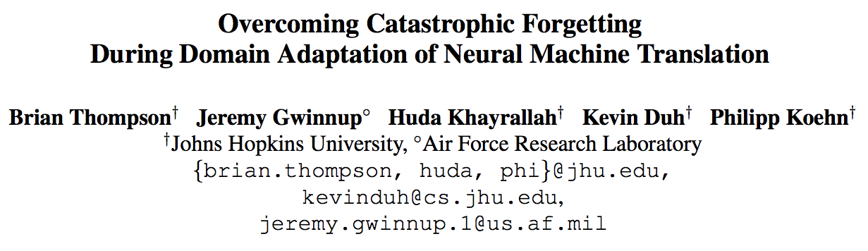
NAACL 2019
Notes:
We have other work to be presented at NAACL that focuses much more on this problem
does not improve adaptation

Slide 54
German-English Medical – Small
+ 0.2
BLEU
Notes:
Adapting on just 2k lines

Slide 55
English-German Medical – Small
+ 0.2
BLEU
Notes:
Adapting on just 2k lines

Slide 56
Overview
Overview of Neural Machine Translation (NMT)
Overview of Domain Adaptation
Improving Domain Adaptation
Regularized Training Objective for Continued Training for Domain Adaptation in Neural Machine Translation [Khayrallah, Thompson, Duh & Koehn 2018]
Analysis of Noisy Corpora
On the Impact of Various Types of Noise on Neural Machine Translation [Khayrallah & Koehn 2018]

Slide 57
On the Impact of Various Types of Noise on Neural Machine Translation
Huda Khayrallah & Philipp Koehn
WNMT at ACL 2018 [Outstanding Contribution Award]

Slide 58
De→En translation
 | NMT | SMT
WMT17 | 27.2 | 24.0
+ noisy corpus | 17.3 (-9.9) | 25.2 (+1.2)

Slide 59
More data is better!
BLEU
[Koehn & Knowles 2017]
Statistical MT with big LM
Statistical MT (SMT)
Neural MT (NMT)
Corpus size (English words)
Notes:
En-Spanish

Slide 60
More data is better!
BLEU
[Koehn & Knowles 2017]
Statistical MT with big LM
Statistical MT (SMT)
Neural MT (NMT)
Corpus size (English words)
Notes:
En-Spanish
There is new work that shows NMT can be better here!

Slide 61
More data is better!
BLEU
[Sennrich & Zhang 2019]
Corpus size (English words)
Notes:
CAVEAT – DIFFERENT LANG pair, different data, cant compare numbers directly
https://www.aclweb.org/anthology/P19-1021/

Slide 62

Let’s go get more data!
Notes:
I focus on webcrawled data in this talk
Primarily EU funded so broad coverage of EU languages (including Low resource: eg. Irish, Maltese)
But also other langs: Sinhala, Nepali,

Slide 63

Annual growth in prices came in at 10.9 per cent, more than double the gain of the 12 months to August 2013, but the gains were not evenly spread across the country.
Notes:
Sentence from:
Newstest 2015 de-en reference
http://www.statmt.org/wmt15/translation-task.html

Slide 64
De→En translation
 | NMT | SMT
WMT17 | 27.2 | 24.0
+ raw paracrawl | 17.3 (-9.9) | 25.2 (+1.2)
+ filtered paracrawl | 32.4 (+5.2) | 25.8 (+1.8)

Slide 65
Raw Paracrawl
2.5% | 5% | 10% | 25% | 50%
NMT | SMT
Notes:
SMT Blue
NMT green

Slide 66
Manual Analysis
Notes:
Short Segments <=2 1%
Short Segments 3 - 5 5%

Slide 67
Noise Types
Misaligned Sentences
Misordered words
Wrong Language
Untranslated Sentences
Short Segments
Notes:
Not practical to annotate all of paracawl for noise types
We generate artificial noise in an attempt to mimic these situations to analyze how MT reacts to each
I’m going to go through them all one by one. In general, most impact NMT more than SMT, but one was catastrophic for NMT

Slide 68
Misaligned Sentences
Notes:
sentences that are not translation of each other, but ok on their own

Slide 69
Misaligned Sentences
Die Koalas sind süß
Die Kängurus springen
Der Koala ist weich
Das Känguru ist schnell
The koalas are cute
The kangaroos jump
The koala is soft
The kangaroo is fast

Slide 70
Misaligned Sentences
Die Koalas sind süß
Die Kängurus springen
Der Koala ist weich
Das Känguru ist schnell
The kangaroos jump
The koala is soft
The kangaroo is fast
The koalas are cute

Slide 71
Misaligned Sentences
2.5% | 5% | 10% | 25% | 50%
NMT | SMT

Slide 72
Misordered Words
Notes:
product of machine translation, poor human translation

Slide 73
Misordered Words (source)
Die Koalas sind süß
Die Kängurus springen
Der Koala ist weich
Das Känguru ist schnell
The koalas are cute
The kangaroos jump
The koala is soft
The kangaroo is fast
Notes:
product of machine translation, poor human translation

Slide 74
Misordered Words (source)
Koalas Die sind süß
Kängurus springen Die
ist Der weich Koala
schnell Känguru ist Das
The koalas are cute
The kangaroos jump
The koala is soft
The kangaroo is fast

Slide 75
Misordered Words (source)
2.5% | 5% | 10% | 25% | 50%
NMT | SMT

Slide 76
Misordered Words (target)
Die Koalas sind süß
Die Kängurus springen
Der Koala ist weich
Das Känguru ist schnell
The koalas are cute
The kangaroos jump
The koala is soft
The kangaroo is fast

Slide 77
Misordered Words (target)
Die Koalas sind süß
Die Kängurus springen
Der Koala ist weich
Das Känguru ist schnell
koalas cute are The
kangaroos The jump
is The soft koala
fast The is kangaroo

Slide 78
Misordered Words (target)
2.5% | 5% | 10% | 25% | 50%
NMT | SMT
Notes:
Bad in Random ways
systematic noise may hurt worse

Slide 79
Wrong Language
Notes:
Language ID does not work well on single sentences

Slide 80
Wrong Language (French source)
Die Koalas sind süß
Die Kängurus springen
Der Koala ist weich
Das Känguru ist schnell
The koalas are cute
The kangaroos jump
The koala is soft
The kangaroo is fast

Slide 81
Wrong Language (French source)
Les koalas sont mignons
Les kangourous sautent
Le koala est doux
Le kangourou est rapide
The koalas are cute
The kangaroos jump
The koala is soft
The kangaroo is fast

Slide 82
Wrong Language (French source)
2.5% | 5% | 10% | 25% | 50%
NMT | SMT
Notes:
Multilingual MT works

Slide 83
Wrong Language (French target)
Die Koalas sind süß
Die Kängurus springen
Der Koala ist weich
Das Känguru ist schnell
The koalas are cute
The kangaroos jump
The koala is soft
The kangaroo is fast

Slide 84
Wrong Language (French target)
Die Koalas sind süß
Die Kängurus springen
Der Koala ist weich
Das Känguru ist schnell
Les koalas sont mignons
Les kangourous sautent
Le koala est doux
Le kangourou est rapide

Slide 85
Wrong Language (French target)
2.5% | 5% | 10% | 25% | 50%
NMT | SMT
Notes:
We should have been in the wrong language half the time…
This didn’t hurt as much as we expected – perhaps because there was a domain shift between the two different corpora
systems picking up on the domain shift
Either all French or all English, not lots of mixing

Slide 86
Untranslated

Slide 87
Untranslated (English Source)
Die Koalas sind süß
Die Kängurus springen
Der Koala ist weich
Das Känguru ist schnell
The koalas are cute
The kangaroos jump
The koala is soft
The kangaroo is fast

Slide 88
Untranslated (English source)
The koalas are cute
The kangaroos jump
The koala is soft
The kangaroo is fast
The koalas are cute
The kangaroos jump
The koala is soft
The kangaroo is fast

Slide 89
Untranslated (English source)
2.5% | 5% | 10% | 25% | 50%
NMT | SMT
Notes:
multi task
copy & translate (depending on input language)

Slide 90
Untranslated (German target)
Die Koalas sind süß
Die Kängurus springen
Der Koala ist weich
Das Känguru ist schnell
The koalas are cute
The kangaroos jump
The koala is soft
The kangaroo is fast

Slide 91
Untranslated (German target)
Die Koalas sind süß
Die Kängurus springen
Der Koala ist weich
Das Känguru ist schnell
Die Koalas sind süß
Die Kängurus springen
Der Koala ist weich
Das Känguru ist schnell

Slide 92
Untranslated (German target)
2.5% | 5% | 10% | 25% | 50%
NMT | SMT
Notes:
learns to copy
cant *just* filter exact copies
Beam search!!!!

Slide 93
Short Segments
Notes:
<=2
3-5
specialized term lists
Practical in low resource
Recently some papers have come out on dictionary training in NMT, but prior to that there had been concern about this affecting the LM component of NMT

Slide 94
Short Segments
Die
süß
Känguru
schnell
The
cute
Kangaroo
fast

Slide 95
Short Segments
≤ 2 words
2.5% | 5% | 10%
3-5 words
2.5% | 5% | 10% | 25%
Notes:
<=2
3-5
takeaway: goodness depends on how well matched the words are

Slide 96
Notes:
Random noise is not that bad…
But systematic noise causes the model to learn the wrong pattern

Slide 97
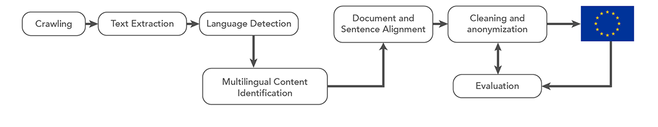
Filtering methods
BiCleaner [Espla-Gomis & Forcada 2009]
Zipporah [Xu & Koehn 2017]
WMT shared task [Koehn, Khayrallah, Heafield & Forcada 2018]
Dual Conditional Cross-Entropy Filtering [Junczys-Dowmunt 2018]
Zipporah [Khayrallah, Xu & Koehn 2018]
Notes:
Paracrawl is high recall
Aan option with paracawrl is to use a filtered version
but we want to see what kind of noise exists to improve it
what kind of noise in data to motivate future filtering work
Shared task – did will, beat zipporah

Slide 98
De→En translation
 | NMT | SMT
WMT17 | 27.2 | 24.0
+ raw paracrawl | 17.3 (-9.9) | 25.2 (+1.2)
+ filtered paracrawl | 32.4 (+5.2) | 25.8 (+1.8)

Slide 99
De→En translation
 | NMT | SMT
WMT17 | 27.2 | 24.0
+ raw paracrawl | 17.3 (-9.9) | 25.2 (+1.2)
WMT19 + filtered paracrawl | 32.4 (+5.2) | 25.8 (+1.8)

Slide 100
Overview
Overview of Neural Machine Translation (NMT)
Overview of Domain Adaptation
Improving Domain Adaptation
Regularized Training Objective for Continued Training for Domain Adaptation in Neural Machine Translation [Khayrallah, Thompson, Duh & Koehn 2018]
Analysis of Noisy Corpora
On the Impact of Various Types of Noise on Neural Machine Translation [Khayrallah & Koehn 2018]

Slide 101
Takeaways
new methods→ improved performance
models consist of methods + data
methods pick up patterns in the data
noise [Khayrallah & Koehn 2018]
annotation artifacts [Poliak et al., 2018]
Bias [Ethics in NLP 2017, 2018; Gender Bias in NLP 2019]
Notes:
Thinking about how to leverage different types of data that differ in quality and quantity
if data is problematic so is the model
Something to think about both as producers of tech (how will this model we are creating be used, and what is is learning in addition to what we want it to learn)
but also as educated consumers of tech/citizens of the world

Slide 102
Questions?
huda@jhu.edu
cs.jhu.edu/~huda

